Slide 1
Benefits of UEFI in
Manufacturing and Test
Intel Corporation
Software and Services Group

Slide 2
Disclaimer
THIS INFORMATION COTNAINED IN THIS DOCUMENT, INCLUDING ANY TEST RESULTS ARE PROVIDED "AS IS" WITH NO WARRANTIES WHATSOEVER, INCLUDING ANY WARRANTY OF MERCHANTABILITY, NONINFRINGEMENT FITNESS FOR ANY PARTICULAR PURPOSE, OR ANY WARRANTY OTHERWISE ARISING OUT OF ANY PROPOSAL, SPECIFICATION OR SAMPLE.INFORMATION IN THIS DOCUMENT IS PROVIDED IN CONNECTION WITH INTEL® PRODUCTS. NO LICENSE, EXPRESS OR IMPLIED, BY ESTOPPEL OR OTHERWISE, TO ANY INTELLECTUAL PROPERTY RIGHTS IS GRANTED BY THIS DOCUMENT OR BY THE SALE OF INTEL PRODUCTS. EXCEPT AS PROVIDED IN INTEL'S TERMS AND CONDITIONS OF SALE FOR SUCH PRODUCTS, INTEL ASSUMES NO LIABILITY WHATSOEVER, AND INTEL DISCLAIMS ANY EXPRESS OR IMPLIED WARRANTY, RELATING TO SALE AND/OR USE OF INTEL PRODUCTS INCLUDING LIABILITY OR WARRANTIES RELATING TO FITNESS FOR A PARTICULAR PURPOSE, MERCHANTABILITY, OR INFRINGEMENT OF ANY PATENT, COPYRIGHT OR OTHER INTELLECTUAL PROPERTY RIGHT. Intel products are not intended for use in medical, life saving, or life sustaining applications.
Intel retains the right to make changes to its specifications at any time, without notice.
Recipients of this information remain solely responsible for the design, sale and functionality of their products, including any liability arising from product infringement or product warranty.
Intel may make changes to specifications, product roadmaps and product descriptions at any time, without notice.
Intel and the Intel logo are trademarks or registered trademarks of Intel Corporation or its subsidiaries in the United States and other countries.
*Other names and brands may be claimed as the property of others.
Copyright © 2008, Intel Corporation
Notes:
Legal disclaimer. Indicates that there are no warranties contained within this slide set and that all intellectual property contained herein is protected.

Slide 3
Agenda
UEFI in Manufacturing Environment
Example Use of UEFI in Manufacturing
Test Advantages through UEFI
Industry Benefits and Support

Slide 4
UEFI Layered Implementation
UEFI in a Manufacturing Environment
OPERATING SYSTEM
Legacy OS LOADER
UEFI OS LOADER
UEFI API
Compatibility
UEFI BOOT SERVICES
UEFI
RUNTIME
SERVICES
UEFI or
Framework
Drivers
Driver
Driver
Memory
Timer
Boot
Devices
Protocols +
Handlers
(OTHER)
SMBIOS
ACPI
PLATFORM SPECIFIC FIRMWARE
INTERFACES
FROM
OTHER
REQUIRED
SPECS
PLATFORM HARDWARE
UEFI SYSTEM
PARTITION
OS PARTITION
Motherboard
ROM/FLASH
Option
ROM
Option
ROM
Option
ROM
UEFI
Drivers
UEFI Drivers
UEFI
Drivers
UEFI OS
Loader
Notes:
This slide illustrates the interactions of the various components of an UEFI specification-compliant
system that are used to accomplish platform and OS boot.
The platform firmware is able to retrieve the OS loader image from the System Partition. The
specification provides for a variety of mass storage device types including disk, CD-ROM, and DVD
as well as remote boot via a network. Through the extensible protocol interfaces, it is possible to add
other boot media types, although these may require OS loader modifications if they require use of
protocols other than those defined in this document.
Once started, the OS loader continues to boot the complete operating system. To do so, it may use
the EFI boot services and interfaces defined by this or other required specifications to survey, comprehend, and initialize the various platform components and the OS software that manages
them. EFI runtime services are also available to the OS loader during the boot phase.
----------------------
The basic take away is that UEFI is really a interface specification
{ENTER}
The platform firmware produces this set (point to the box below UEFI Boot Services)
The closet thing to legacy is the “Int” interfaces like Int 10 int 16 Int 13
In UEFI there are a set of defined interfaces like the UEFI OS Loader, pre boot applications
{point to OS loader}
{ENTER}
There is also a new extensible mechanism to support option ROMs that will work across multiple processors
{point to Option ROM}
{ENTER}
When we talk about the framework I think really what the framework is all about is how do you produce a system that has all of these UEFI interfaces
The UEFI Spec itself is just an API
How does one component talk to another
How does the OS loader talk to the platform
How does the Option ROM talk to the platform
How does the utility talk to the platform
{ENTER}
That’s what UEFI is all about

Slide 5
Relationship of Manufacturing Use of UEFI versus OS boot
UEFI in a Manufacturing Environment
Normal OS
Boot
factory
MFG test
code
OS
Loader
MFG environment migrated to EFI
MFG test code loaded by UEFI
UEFI test code directly interfaces with the HW.
EFI shell
UEFI
UEFI
Hardware
Hardware
Notes:
Add info about using EFI to load the test infrastructure and touch the hardware directly.
Big idea: There’s a difference between using EFI in the end user sense and EFI in the factory.

Slide 6
Factory Flow
Boot to network over PXE
  Initial hardware power-up test with EFI MTA
  Run within Shell with python scripts
Configure cards, Nvram and Drives
  From firmware setup using UEFI driver Configuration protocols and EFI based utilities
Boot to WinPE*
  System test and hardware verification for Windows
  Pull configuration desired for system from RIS over LAN
  Reseal installation at factory

Slide 7
Manufacturing Test Automation (MTA) of UEFI platform
Test Package
File(.pkg)
Test
Executive
T64.EFI
Parse
Command line
Arguments
record
execute
Help
.hlp
Test Execution
Summary
.TXT or .XML
Test Services
Library
.EFI
Test
Module

Slide 8
EFI Toolkit “Tools for the Factory”
UEFI shell
Common Utilities (edit, pci, dmem, mm drivers, dmpstore, dblk, devices, etc.)
Libc
EFI Lib
Network Stack (Tcpip, Dhcp,Ftp, Ping etc)
Configuration of system with Nvram variables and boot manager
  Automatic loading of drivers not in flash
  Executing test environment directly without unnecessary loading of unused drivers.
Python script interpreter
Notes:
Big idea:

Slide 9
UEFI Driver Diagnostics
UEFI Driver Model Drivers (OptionROM code) can have built in diagnostics
Each driver can expose a 4 tiered test
  Standard test
  Extended test
  Manufacturing test
  Maximum test
IHV silicon/card provider should have Diagnostic protocol as part of UEFI driver

Slide 10
UEFI Driver Configuration
UEFI Driver Model Drivers (OptionROM code) may have configuration protocol
Each driver can have different configs
  Set options
  Validate options
  Force defaults
IHV silicon/card provider should have configuration protocol as part of UEFI driver

Slide 11
Advantages of using UEFI interface
Loading of test environment via UEFI
  Unnecessary to write additional code to load test code
  Reuse of UEFI drivers (from Silicon providers and EDK)
  Use EFI shell (interactive)
  EFI shell freely available with source on Tianocore.org
  Written in high level C code
  Test environment the same across architectures
Flat memory model
  Memory can be tested with less interference
  All memory is available (UEFI can be relocated)
Full control of the system
  Very low driver interference
  No interrupts required except for EFI timer
  UEFI test software has direct contact with hardware
    CPU in Physical mode with no address translation
    No OS kernel interference for I/O or memory access
    Only one core used, other cores in Sipi rendezvous loop

Slide 12
Test Time advantages (Motherboard)
Reduced pretest time (booting to UEFI)
  Need only bare minimum drivers to load or run EFI Shell
  Unnecessary to load drivers not used to load test environment
Faster test time
  i.e. boot from LAN(pxeboot) with built in lan drivers
Requires fewer reboots (can be 0)
Run stop or disconnect on UEFI drivers used during test instead of reboot
Can still boot to OS
  Just load the UEFI OS Loader from shell or boot manager

Slide 13
Test portability
Test code can compile for all platforms
  IA-32, Intel® Itanium® Platform, Intel® 64
UEFI test environment can be identical between architectures (cross compiled)

Slide 14
Test Binary Locations
EFI has built in network stack
EFI images can run from:
  The firmware image
  Local Media (HDD, USB, CD\DVD ROM)
  Network share
Choosing non local media:
  No impact on customer image
  No risk of corrupting files
  Station re-imaging is eliminated

Slide 15
Example:
Advanced Components Division (ACD) and Chipset Platform Validation(CPV) using UEFI
Impact of testing Advanced Host Controller Interface (AHCI) with UEFI driver
  10,658 capacity improvement per module
  32K capacity improvement per 3 modules
  One module cost 1.5$ + floor space. Estimated savings >2M$
  Factory has no floor space to add more module

Slide 16
EFI Standard Test Vision
EFI Standard Test Interface
  Industry standard interface for a “test module” to communicate with a “test engine”
    Leverage validation product
    Eliminate duplicate work
  Tests from multiple companies interoperate
    IHVs provide tests for their components
    OEMs provide tests for their boards

Slide 17
EFI Standard Test Vision
Currently being worked through UEFI Forum
  Influence your future
  Everyone is invited
    some are contributors to UEFI already
Open source test executive
  Allows for customization:
    Configuration information
    Data collection
    Operator interactions

Slide 18
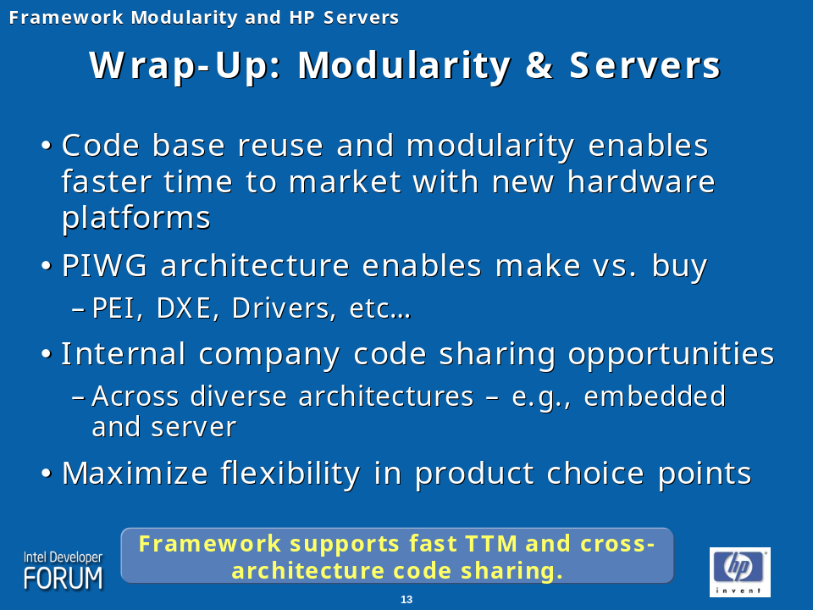
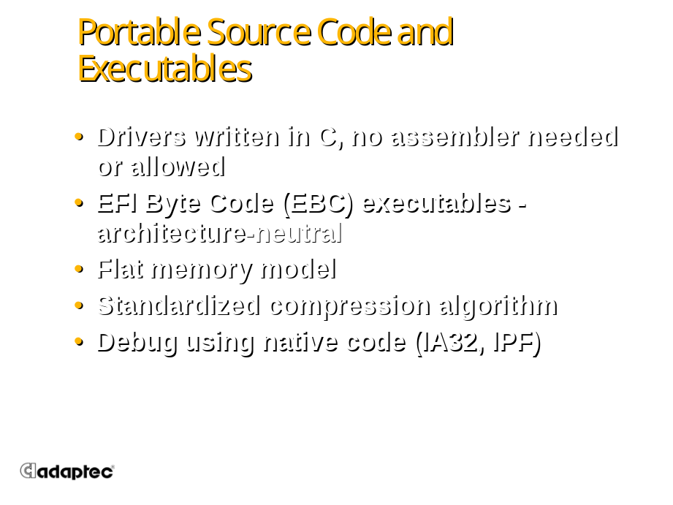
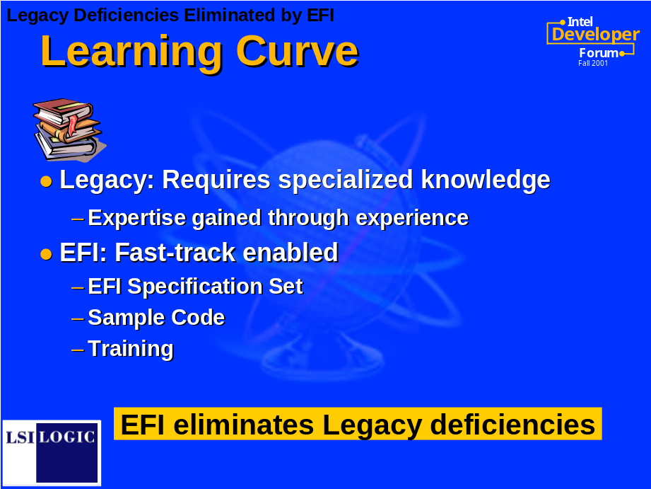
Developer thoughts

Slide 19
Web Resources
www.UEFI.org
  UEFI Specification
www.TianoCore.org
  Open Source (EFI Developers Kit, Shell, etc…)
  Mailing lists for help and reporting issues
www.Intel.com/Technology/Framework
  Intel’s Framework Specs
www.Intel.com/Technology/EFI
  Intel’s EFI website

Slide 20




Q & A

Slide 21


Slide 22

Back up
Back Up

